Slide 1
360° Vision Sensors and Head Mounted Displays for Land Vehicles
CLASSIFICATION
Kieran Hunt & Harvey Prom
Notes:
One of the research areas within Advanced Vehicle Systems is into the improvement of vehicle sensors. To this end, we have been focusing on emergent technologies such as 360 degree video and Virtual Reality as potential additions to our Land Vehicles.
So, what can 360 degree video and VR bring to our next generation land vehicles?

Slide 2
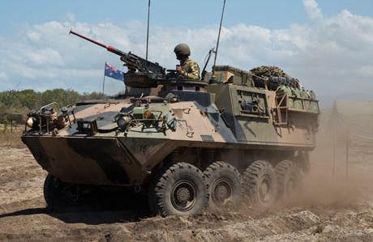
Situational Awareness vs Safety
CLASSIFICATION
Current trade-off:
Awareness
Safety
Proposed Solution: 360° Video and VR Displays
Notes:
To answer that, we need to understand the value of situational awareness and safety.
When on deployment, situational awareness is what keeps our soldiers alive. Being able to accurately assess a situation, identify potential threats in the environment, and act appropriately. This capability is vital as without it, the lives of our servicemen and women are put at risk.
This becomes a problem when awareness is limited in order to provide adequate protection. For example, the M113 Armoured Personnel Carrier is often operated with hatches open to allow operators a greater field of view. This exposes the personnel to enemy fire. In dangerous situations, the hatches go down, and the vehicle is then operated using a restricted field of view using external cameras or view ports. In this scenario, the vehicle now is less capable of making tactical decisions, reducing its effectiveness on deployment.

Slide 3
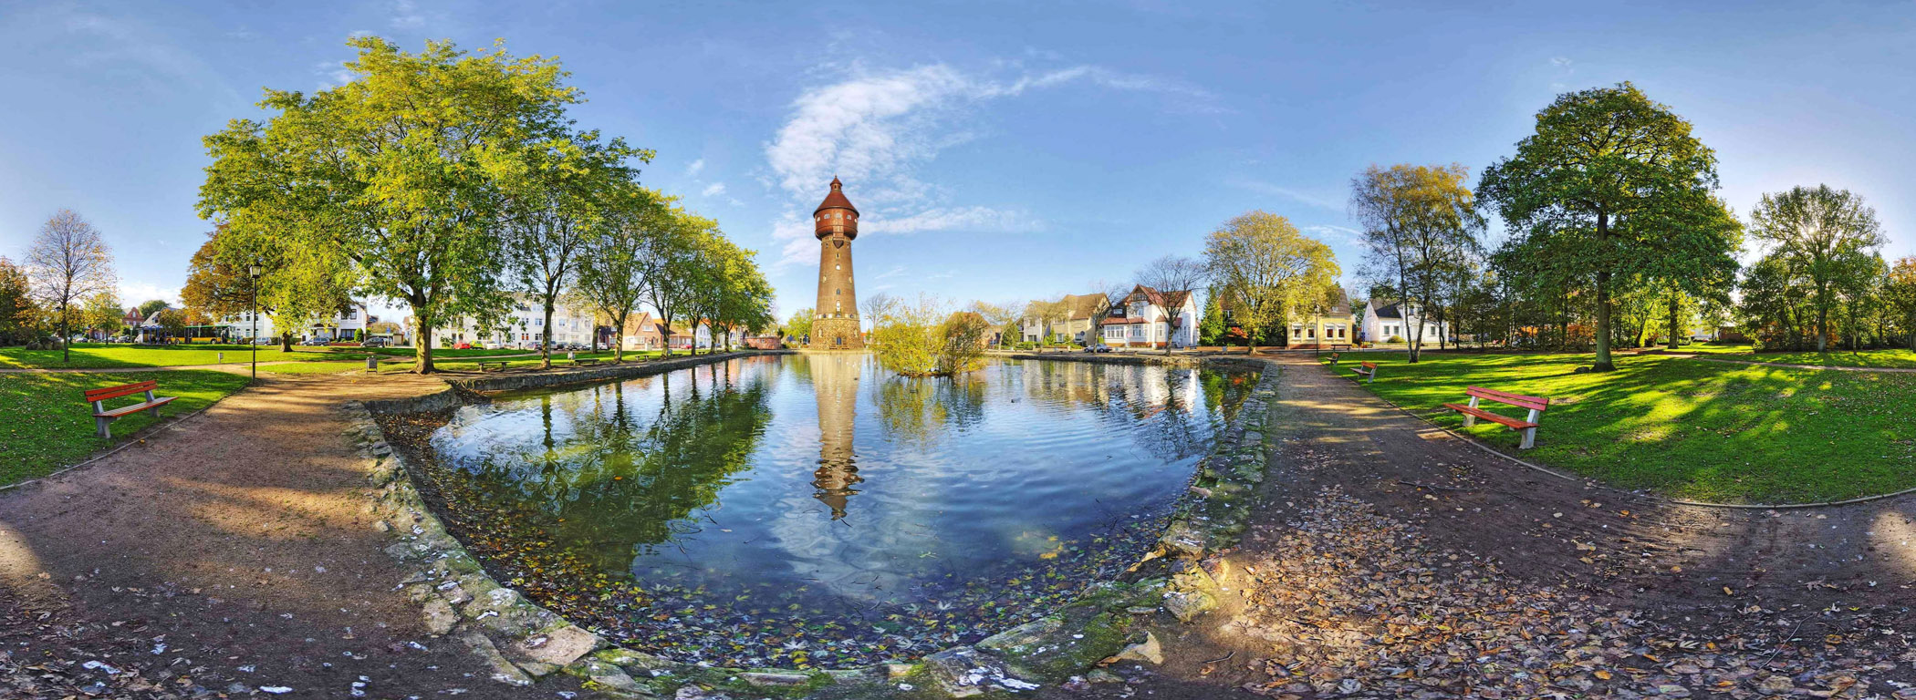
How can 360° Cameras Help?
CLASSIFICATION
Provides video input of all surroundings
Imitates the FOV an operator would have outside the vehicle
Notes:
A solution to this problem is the use of a 360 degree camera system. This uses an array of wide angle cameras on a single device to record footage from any direction. These images can then be stitched together to make a panoramic view of the camera’s surroundings.
While technically providing vision to all points around the vehicle, this is somewhat difficult to utilise this video as a 2 dimensional image. The image is warped due to the panoramic view and it is sometimes difficult to get accurate information about the environment quickly and easily.

Slide 4
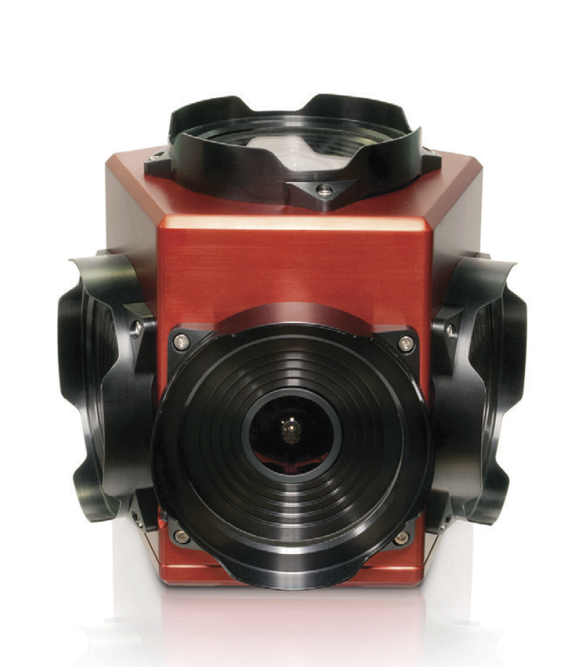
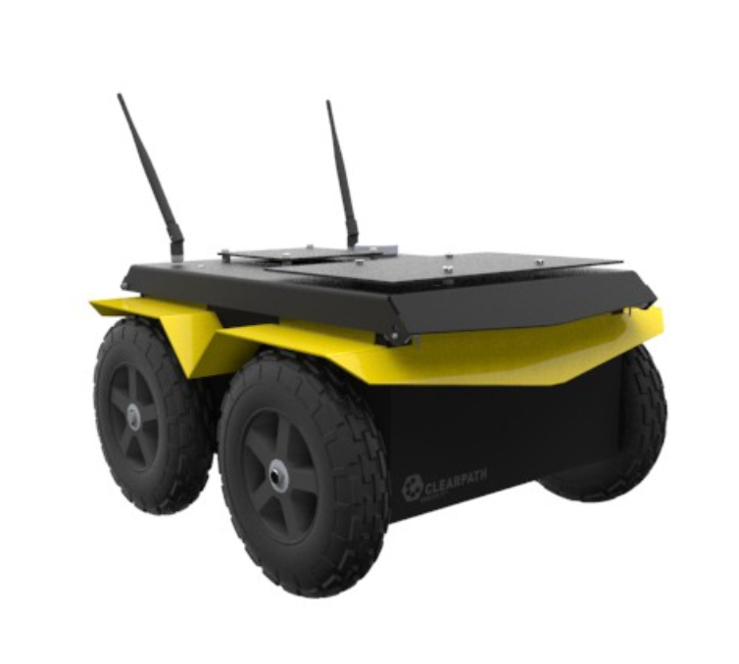
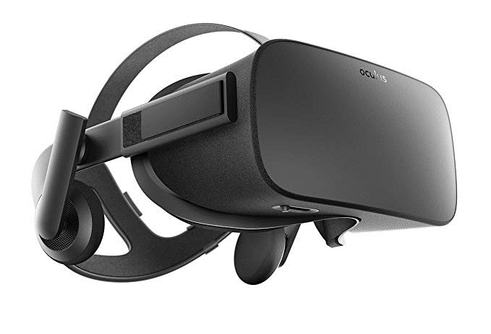
Implementation
CLASSIFICATION
Notes:
For this project, we wanted to implement a basic version of this technology using a Jackal UGV as a testing platform. The aim was to install a 360 degree camera onboard the robot and stream the video to another PC. Put simply, we wanted to put that camera on the Jackal UGV as a proof of concept.

Slide 5
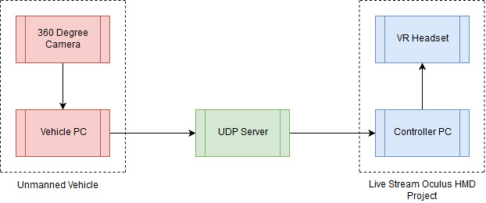
Design Architecture
CLASSIFICATION
Notes:
Here you can see the rough architecture we used for this project. I was responsible for developing the hardware and software on the left side of the diagram, in particular the camera interface. Next we had to find a method to packetize and send the images recorded by the camera via UDP to be used by the Live Stream Oculus HMD Project being completed by Harvey Prom.

Slide 6
C# and C++Implementation
C# application contains full initialising procedure, but can’t save images.
Rudimentary communication via UDP achieved
C++ application captures and saves 6 images per frame in jpeg format.
Based on modified LadybugSimpleGrab examples.

Slide 7
Application Performance
Av = 3.8199 fps

Slide 8
Network Requirements
6 images capture per frame, 700 kB each
Approximately 4.2 MB of data per frame
Video Speed (fps) | Throughput (MB/s) | Network Speed (Mb/s)
15 | 63 | 504
30 | 126 | 1008
60 | 252 | 2016
Data Transmission Requirements to support Ladybug5+ at different framerates

Slide 9
Results
CLASSIFICATION
Functional Camera software interface
Rudimentary data streaming via UDP
Ladybug5+ performance potentially limited by:
Restricted network bandwidth
Insufficient code optimisation and processing power
Notes:
From this project, we’ve successfully developed a software interface between the camera and other devices. We have also been able to implement basic data streaming via UDP, however this is limited by available bandwidth and the constraints imposed by DS 00-82. Right now we are aiming to be able to continue working on this project into its next phase of development as part of LOAVES.

Slide 10
Recommendations
Ladybug5+ is likely unsuitable for deployment on platforms such as the Jackal
Recommend further testing on LOAVES
C++ application requires extensive optimisation before usable performance is achieved.

Slide 11
Project Handover
USB Drives contain all code and documentation
Research Journal is catalogued highlighting useful pages

